Slide 1
NASA SLI Cedar Park Rocket Team
Magnetic g-Force Remediation
Notes:
Hello, we are the Cedar Park Rocketry team, and we would like to present to you our NASA SLI project idea. We will first cover the rocket requirements

Slide 2
Our Rocket Requirements
The rocket must reach 5,280 feet above ground level
The Rocket payload should delay or equalize the effects of G-Forces on the inside container by using magnetic fields

Slide 3
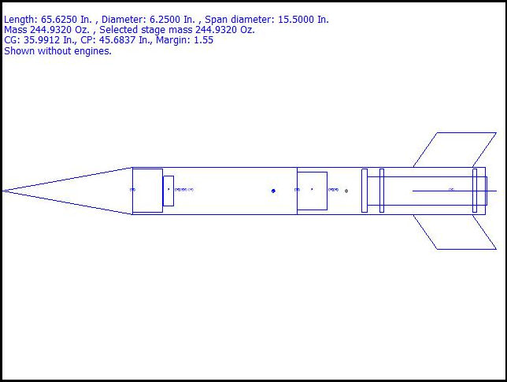
Our preliminary Rocket design and Goals
Rocket stability margin: 1.55
Center of gravity: 35.99 in
Center of diametric pressure: 45.68 in

Slide 4
Notes:
Talk about thrust patterns and why you chose them. One of the reasons we choose the motor we did was for the specific thrust patterns.
The thrust patterns that we chose with an expedient acceleration pattern insures a safe, successful and reliable flight.

Slide 5
Parts and Materials
Motor: Aerotech K560W
Carbon Fiber fins
Fiberglass body with epoxy bonds
Plastic nosecone

Slide 6
Recovery System
Redundant black powder charges, circuit systems, and batteries for both the drogue and main parachutes.
Notes:
Talk about parachute and drogue.

Slide 7
Initial Payload Ideas
Carbon Nano wire test electrical current while experiencing G-forces
Carbon Nano wire stress test under G-forces
Slime mold growth rate after experiencing G-forces
Notes:
These were some other ideas we had for possible payloads. The first experiment would’ve been to test the conductivity of carbon nano-wires under stress compared to other more common types of wires. It would be done by stringing the wires parallel to the ground then hooking the wires up to batteries and devices that will record the amount of amps coming through the wires compared to a control on the ground.
The second experiment is a more simple version of the first, where we would only be testing the strength of the nano-wire compared to the others, instead of conductivity. In this variation there would be a small weigh placed on top of the wires, there would be no need for batteries or measurement equipment, and the control would just be a before picture.
The reason the nano-wires are applicable to real life is that they could be used in spacecraft, but if they couldn’t survive the conditions of launch then they would be useless. We didn’t use these experiments because nano-wires are a complex topic that we know almost nothing about, and we didn’t have the time to learn enough about them to make a convincing argument.
The last experiment on this list was meant as a backup for our final decision, incase something didn’t pan out the way we envisioned it. The experiment would be to test the effect of high g-forces on the growth rate and pattern of slime mold. To test this we would send the slime mold sclerotium, the dormant stage of slime mold, up in the rocket, and once back down we would revive it and grow it next to a control. Slime molds in their dormant form can survive extreme conditions, and if they can survive rocket launches unaffected then they might be something to worry about. Exposing them to conditions like this could also possibly shed some light on the inner workings of slime molds, and perhaps ways of stopping them. The reason we aren’t, and hopefully won’t, use this experiment is because it’s basically a variation of the sending something up and then growing it experiment with a different, albeit interesting, organism.

Slide 8
Final Payload choice
Magnetic Dampening
Using magnetic levitation to diminish G-forces experienced by the payload
Notes:
For our final design we went with a payload that would use magnetic levitation to reduce G-forces (it would act like an invisible cushion). The payload will consist of an inner tube with magnets on the inside on the top and bottom. This tube would fit vertically into the body of the rocket, with empty space above and below to allow the inner tube to move up and down freely. Above and below the inner tube will be normal magnets, which will work with the diamagnets to levitate the inner tube, hopefully reducing the G-forces. The magnets used will be grade N52 neodymium magnets, and the diamagnets used will either be made of bismuth or pyrolytic carbon. Although it might be possible to use superconductors and liquid nitrogen to levitate the payload. If for some reason the diamagnets don’t work out, it would be possible to use normal ferromagnets since the inner tube is constricted to only moving up and down. Originally we were going to do a free floating sphere with magnets pointing in six different directions, but we ended up going with our current design since it was simpler, safer, and most of the G-forces that the payload would experience would be vertical (relative to the rocket) anyway. To test if the magnetic levitation system was really equalizing the G-forces two accelerometers would be placed, one in the inner tube, and the other outside of it acting as the control. Magnetic dampening could be used in real life to reduce G-forces on astronauts and payloads during launch, when the rocket fires its engines, and especially during landing and parachute deployment. The reduced G-forces could allow for more powerful engines and heavier landers to be used with humans and delicate equipment, allowing for more complex missions further into space. This technology however will not decrease the average g forces upon the rocket. Instead it will only change the peak g forces on take off, landing and acceleration. The possible future applications of this technology is endless. futhermore in the right hands this technology has the ability to shape space travel as we know it.

